Slide 1
USB 3.1 Type C Cable Signal integrity Test Fixture Introduction
Measurement Development Center (Taiwan)
July. 04, 2016

Slide 2
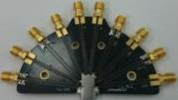
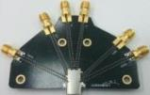
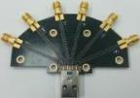
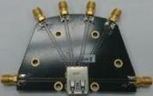
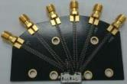
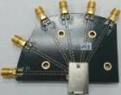
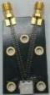
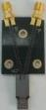
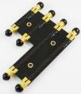
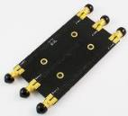
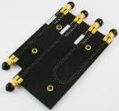
USB 3.1 Type C Cable Signal integrity Test Fixture
Type-C Test board
High Speed Type-C Test board
Low Speed Type-C Test board
3.1 Type A Plug
3.1 Type A Receptacle
3.1 Micro-B (Receptacle)
3.1 Type-B (Receptacle)
2.0 Micro-B
Legacy USB Connector Test Board
2.0 Mini-B
USB Adaptor
Thru
SOL
TRL
Calibration Board

Slide 3
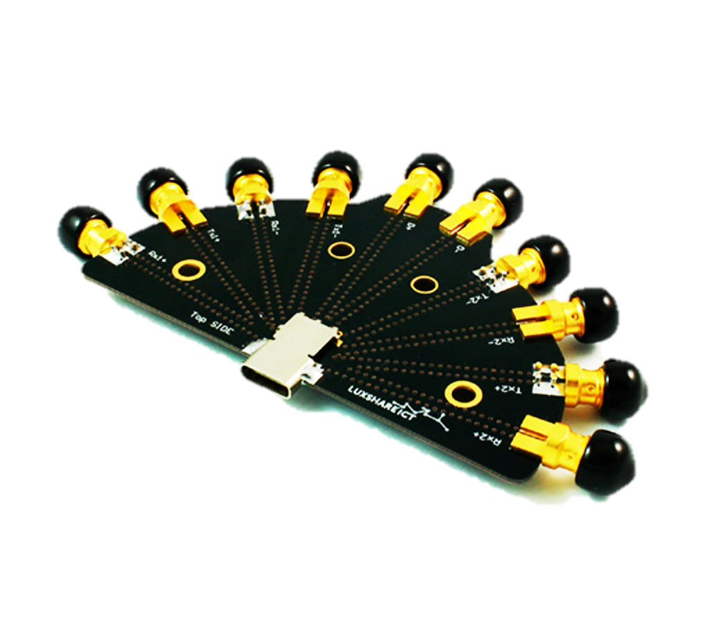
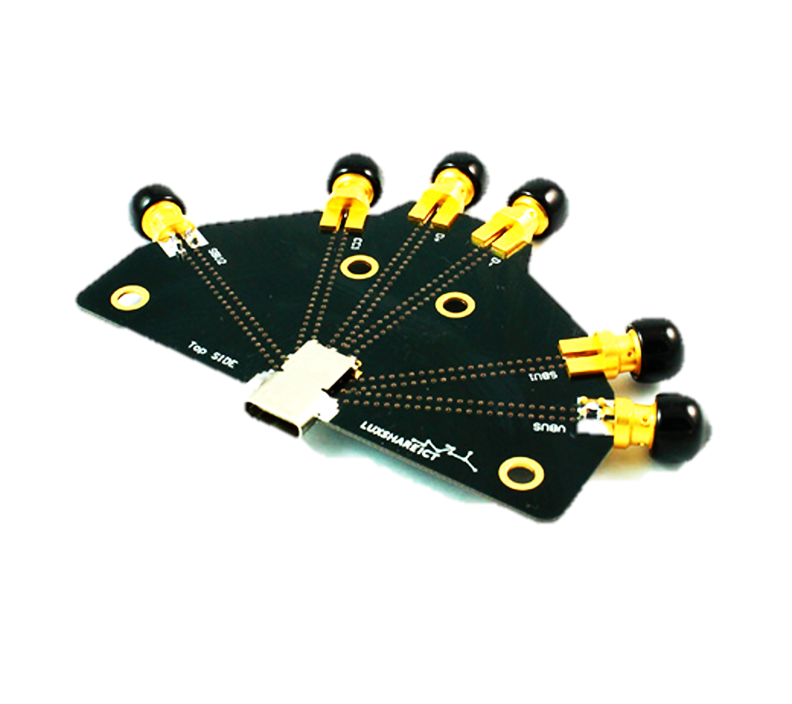
Type C to C Cable Test
ENA/PNA
USB Type C Receptacle High Speed
TFU-23R2R
USB Type C Receptacle High Speed
TFU-23R2R
Type C to Type C Cable
DUT
USB Type C Receptacle Low Speed
TFU-24R3R
USB Type C Receptacle Low Speed
TFU-23R3R

Slide 4
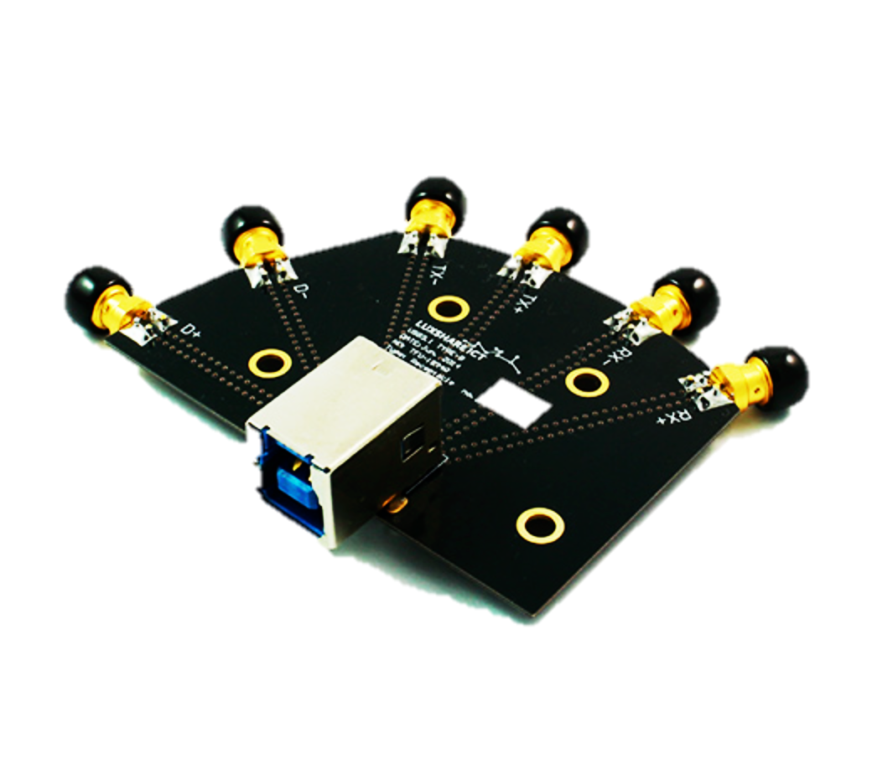
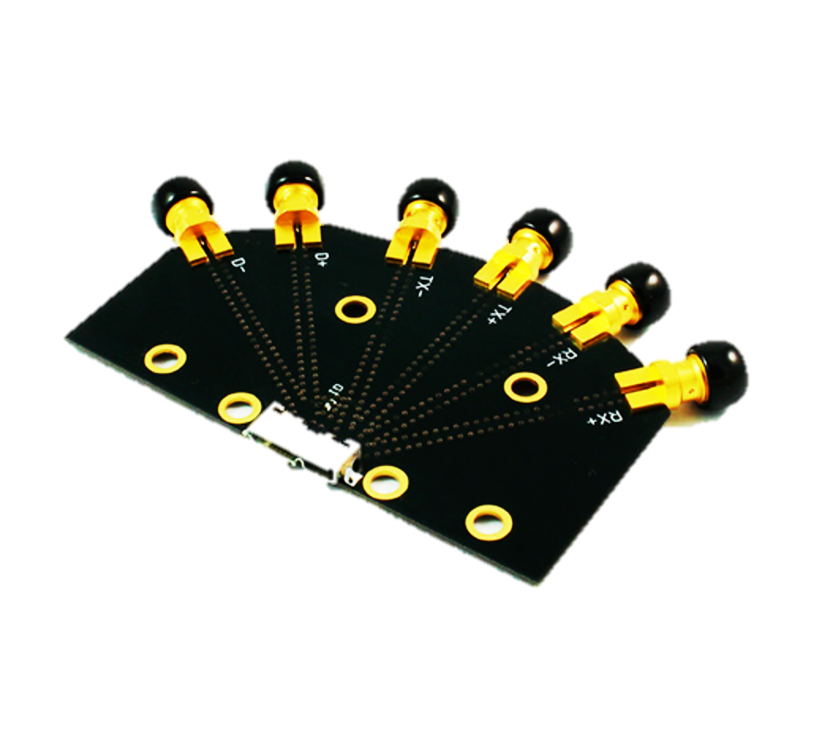
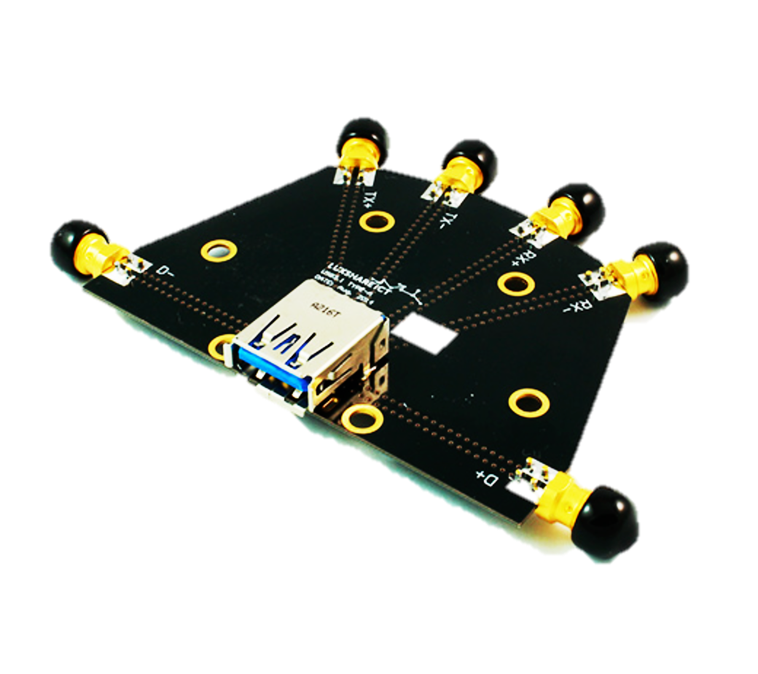
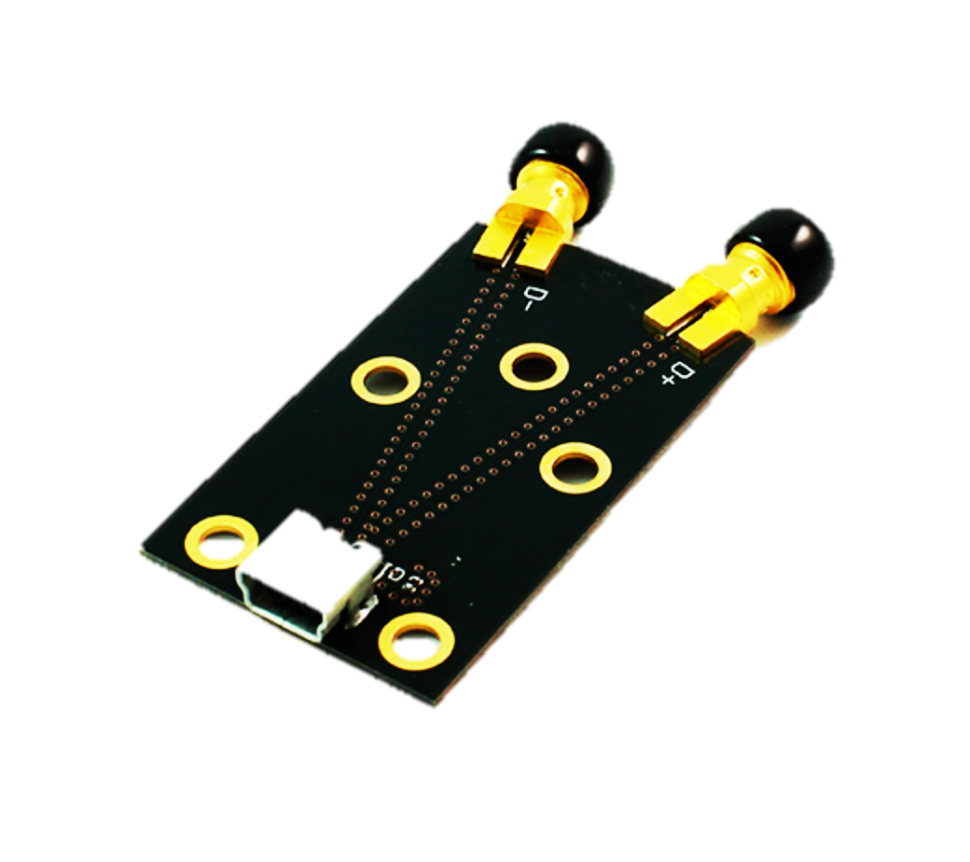
Type C to Legacy Cable Test
ENA/PNA
USB 3.1 Type B
Receptacle
TFU-19R4R
USB Type C Receptacle High Speed
TFU-23R2R
USB 3.1 Micro B
Receptacle
TFU-14R4R
Type C to Legacy Cable
DUT
USB 3.1 Type A Receptacle
TFU-12R4R
USB Type C Receptacle Low Speed
TFU-23R3R
USB 2.0 mini B Receptacle
TFU-26R4R

Slide 5
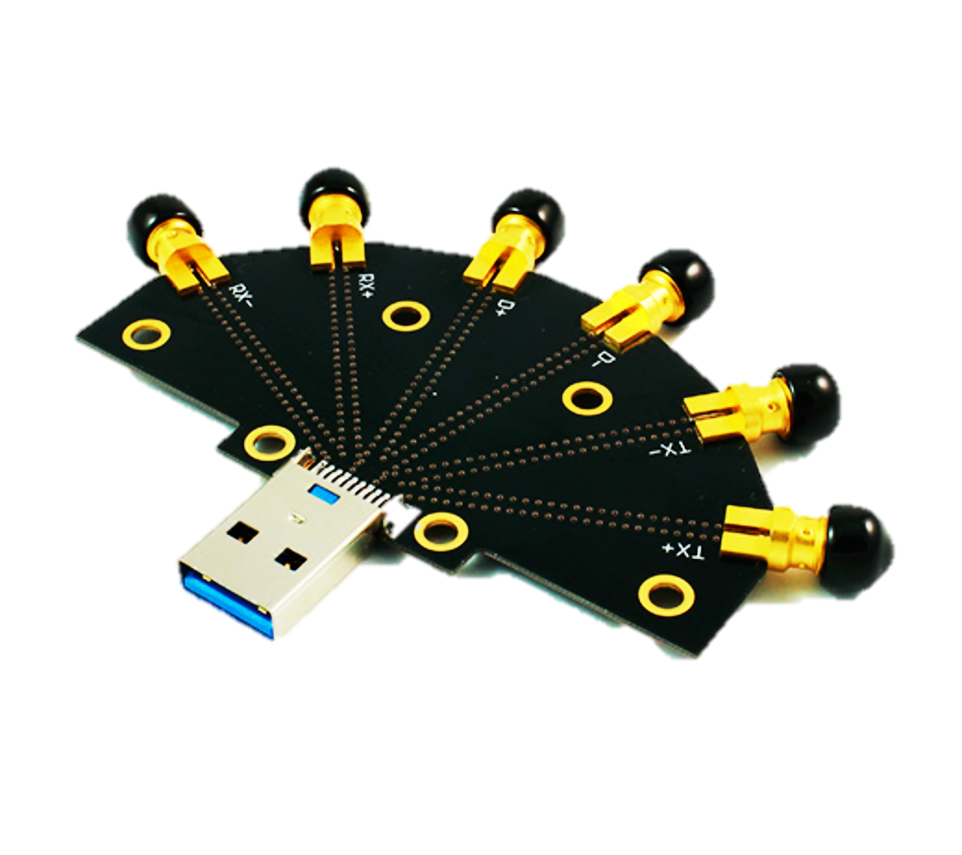
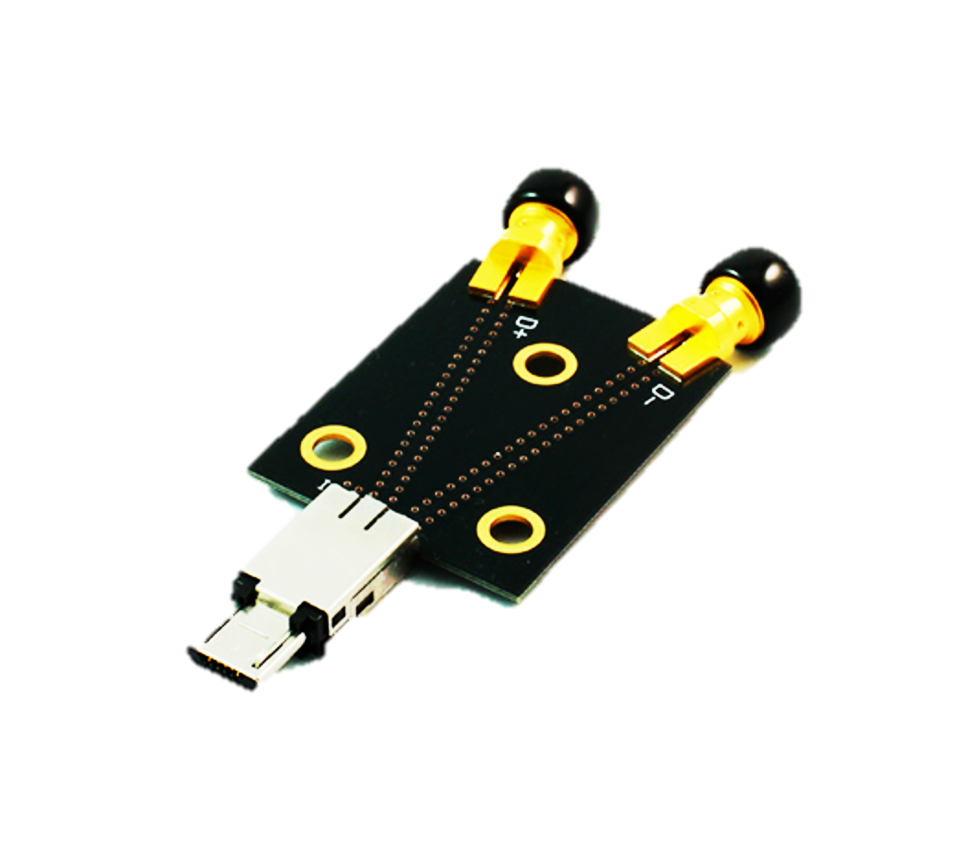
Type C to Legacy Adapter Cable Test
ENA/PNA
USB 3.1 Type A Plug
TFU-12P4R
USB Type C Receptacle High Speed
TFU-23R2R
Type C to Legacy Adapter Cable
DUT
USB 2.0 Micro B Plug
TFU-25P4R
USB Type C Receptacle Low Speed
TFU-23R3R

Slide 6


連結創新, 成就未來 Smart Link, Bright Future
6

